Slide 1
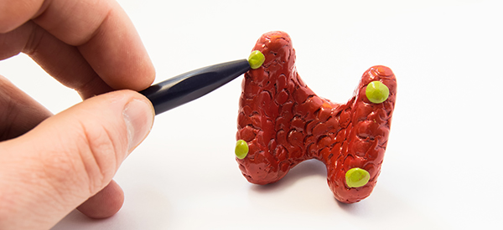
Hyperparathyroidism
By
Maher Abdul Ameer

Slide 2
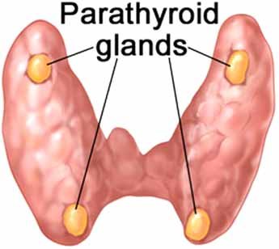
parathyroid glands
The parathyroid glands secrete PTH to help control the levels of calcium and phosphorous in the body. There are usually four parathyroid glands, located on the outside borders of the thyroid gland in the front of the neck.

Slide 3
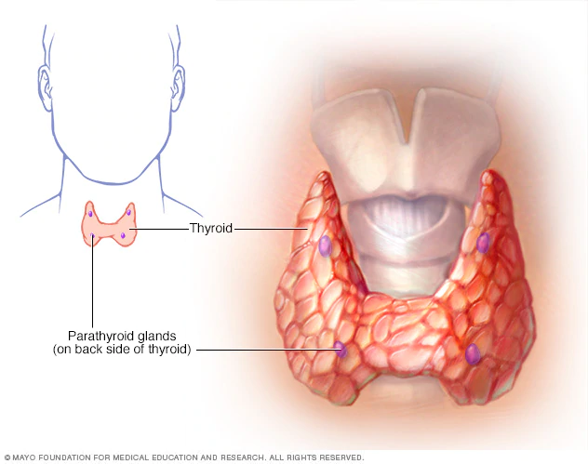
Hyperparathyroidism
is a condition in which one or more of the parathyroid glands become overactive and secrete too much parathyroid hormone (PTH). This causes the levels of calcium in the blood to rise, a condition known as hypercalcemia.

Slide 4
Signs and symptoms
Excessive urination
Abdominal pain
Weakness
Depression
Bone and joint pain
Frequent complaints of illness with no apparent cause
Nausea, vomiting or loss of appetite

Slide 5
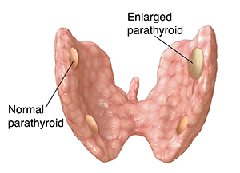
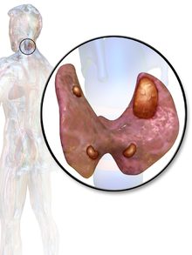
Causes
Primary hyperparathyroidism occurs because of some problem with one or more of the four parathyroid glands:
A noncancerous growth (adenoma) on a gland is the most common cause.
Enlargement (hyperplasia) of two or more parathyroid glands accounts for most other cases.
A cancerous tumor is a very rare cause of primary hyperparathyroidism.

Slide 6
Causes
Secondary hyperparathyroidism is the result of another condition that lowers calcium levels. This causes parathyroid glands to overwork to compensate for the calcium loss. Factors that may contribute to secondary hyperparathyroidism include:
Severe calcium deficiency.
Severe vitamin D deficiency.
Chronic kidney failure.

Slide 7
Complications
Osteoporosis: The loss of calcium often results in weak, brittle bones that fracture easily (osteoporosis).
Kidney stones: Too much calcium in the blood may lead to too much calcium in urine
Cardiovascular disease: high calcium levels are associated with cardiovascular conditions, such as high blood pressure and certain types of heart disease.
Neonatal hypoparathyroidism: Severe, untreated hyperparathyroidism in pregnant women may cause dangerously low levels of calcium in newborns.

Slide 8
Diagnosis
Hyperparathyroidism is usually diagnosed with routine blood tests measuring the levels of parathyroid hormone (PTH), calcium and related minerals.
Urine Tests: Analyzing the urine during a 24-hour window can determine how much calcium the body is excreting.
Bone Density Test: Looking at the bones detects any bone loss or weakening.
X-ray, Ultrasound and Computed Tomography Scan (CT scan): Scans can identify blockages caused by excess calcium and any bone fractures.

Slide 9
Treatment
Surgery
Is the most common treatment for primary hyperparathyroidism and provides a cure in most cases. A surgeon will remove only those glands that are enlarged or have a tumor.
Complications from surgery aren't common:
Damage to nerves controlling the vocal cords
Long-term low calcium levels requiring the use of calcium and vitamin D supplements

Slide 10
Drugs
Calcimimetics: A calcimimetic is a drug that mimics calcium circulating in the blood.
The most commonly reported side effects of cinacalcet are joint and muscle pain, diarrhea, nausea, and respiratory infection.
Hormone replacement therapy: For women who have gone through menopause and have signs of osteoporosis, hormone replacement therapy may help bones retain calcium.
Some common side effects of hormone replacement therapy include breast pain and tenderness, dizziness, and headaches.
Bisphosphonates: Bisphosphonates also prevent the loss of calcium from bones and may lessen osteoporosis caused by hyperparathyroidism.
Some side effects associated with bisphosphonates include low blood pressure, a fever and vomiting.

Slide 11
Nursing management
Monitor how much calcium and vitamin D: Restricting dietary calcium intake
Drink enough fluids, mostly water, to produce nearly clear urine to lessen the risk of kidney stones.
Regular exercise, including strength training, helps maintain strong bones.
Don't smoke: Smoking may increase bone loss as well as increase risk of a number of serious health problems.
Avoid calcium-raising drugs: Certain medications, including some diuretics and lithium, can raise calcium levels.

Slide 12
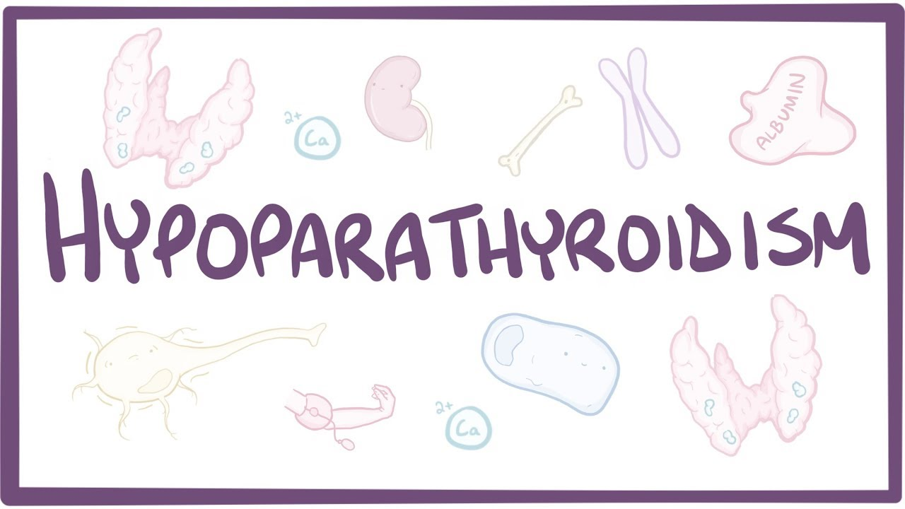

Slide 13
Hypoparathyroidism
is a rare condition that occurs when the parathyroid glands in the neck don’t produce enough parathyroid hormone (PTH). PTH is key to regulating and maintaining a balance of two minerals in the body — calcium and phosphorus.
The low production of PTH in hypoparathyroidism leads to abnormally low calcium levels in the blood and to an increase of phosphorus in the blood.

Slide 14
Causes
The causes of hypoparathyroidism include:
Injury to or removal of the parathyroid glands
Genetics
Autoimmune disease
Cancer radiation treatments
Low magnesium levels

Slide 15
Signs and Symptoms
Remember “PTH”
Paresthesia (tingling sensation on the mouth, face, and finger/toes), Positive Trousseau’s sign or Chvostek’s sign (due to hypocalcemia).
Tetany (severe) due to low calcium and high phosphate level which is involuntary muscle cramping and contraction: bronchospasm and laryngospasms, hand/feet spasms, seizures, EKG changes.
Hypocalcemia and Hyperphosphatemia

Slide 17
Diagnosis
Medical history and physical examination.
Blood tests:
A low blood-calcium level
A low parathyroid hormone level
A high blood-phosphorus level
A low blood-magnesium level
Urine test : to determine if excess levels of calcium are being secreted in the urine.
Electrocardiogram(ECG) measures the electrical activity in the heart.
X-rays and bone density tests can help to determine if low calcium levels have affected the bones.

Slide 18
Treatment
Oral calcium carbonate tablets: Oral calcium supplements can increase calcium levels in blood.
Vitamin D: High doses of vitamin D, generally in the form of calcitriol, can help your body absorb calcium and eliminate phosphorus.
Magnesium.
Parathyroid hormone (Natpara): The U.S. Food and Drug Administration has approved this once-daily injection for treatment of low blood calcium due to hypoparathyroidism.

Slide 19
Nursing Interventions for Hypoparathyroidism
Monitor calcium (normal 8.6 to 10.0 mg/dL) and phosphate levels (normal 2.7 to 4.5 mg/dL)
Monitor airway due to tetany and seizures (bronchospasm/laryngospasms)…prepare for the worst…have a trach kit, oxygen, suction at bedside)
Ensure patient eats a diet high in calcium (dairy, green leafy vegetables) and low in phosphate (organ meats, soft drinks, eggs)

